Slide 1
Job Search

Slide 2
How to Deconstruct a Job Posting
https://youtu.be/RSrS2V-HOPg [How to Read a Job Posting 2:54 min]
https://youtu.be/9OdnsdJrMNE [How to Read Job Postings 5 min]

Slide 3
Deconstructing Job Postings

Slide 4

Why deconstruct?
Allows applicant to mold and modify their resumes to ensure maximum appeal
Saves time, money and mental stress
Makes room for self-reflection, introspection, and self-analysis
Incorrect analysis of job posting drastically reduces chances of getting hired

Slide 5
Time job seekers spend in decoding a job posting:
49-77 seconds
Time job seekers SHOULD spend in decoding a job posting:
15-30 minutes
Applicants need to take time to dissect the job posting and verify it’s worth applying for.

Slide 6
A typical job posting has…
General overview or summary of the company and the role
Key responsibilities section, listing job duties
Qualifications section, which includes educational requirements, certifications, years of experience and other skills

Slide 7

Deconstructing Job Ads…
Job titles can be misleading
Understand if you are a “FIT”
Check the job duties
Do you meet the requirements?
Read between the lines
Research the company
Most importantly, think whether you WANT this job!

Slide 8



Things to keep in mind…
Don’t let excitement get in the way
Look for clues in the company values
Pay attention to keywords and repeat phrases
Consider preferred method of communication
Don’t apply for jobs that ask for personal information
See if there is room for growth and improvement

Slide 9

What to look at…?
Job Title
Eligibility criteria
Responsibilities
About us
Skills and Abilities
Location
Benefits and Pay

Slide 10


Self-Analysis
Assessment of qualifications
Assessment of acceptance of work environment
Educational qualifications
Previous experience
Types of soft and hard skills
Colleagues and Superiors
Location
Job duties and responsibilities
Working hours and conditions

Slide 11
Self-Analysis
Assessment of personal satisfaction
Rewards and recognition
Accomplishments
Growth and progress

Slide 12
“Lots of growth opportunity”
Make sure the company is actually one where you can see yourself working for a long time
Some common phrases used in job postings
work for minimal pay in exchange for the “opportunity” to toil away on weekends and maybe exercise your stock options if the company finally goes public

Slide 13
Flexibility on Work Hours
Some common phrases used in job postings
They don’t mean they’ll be flexible with your schedule. Instead, you’re expected to be flexible on their terms.

Slide 14
Flexibility on Work Hours
Some common phrases used in job postings
They don’t mean they’ll be flexible with your schedule. Instead, you’re expected to be flexible on their terms.

Slide 15
“Ability to identify and resolve problems”
If you like to brainstorm and come up with solutions, think of becoming a consultant instead of a full-time employee
Some common phrases used in job postings
There is a lack of cohesive leadership, so the person in this position needs to be able to work without much direction.

Slide 16
“Ability to identify and resolve problems”
Some common phrases used in job postings
This company is dysfunctional, and we are expecting you to turn things around.

Slide 17
“Willingness to work independently”
If you’re interviewing with your prospective boss, try to see if he has a sense of the day-to-day responsibilities of this position
Some common phrases used in job postings
There is a lack of cohesive leadership, so the person in this position needs to be able to work without much direction.

Slide 18
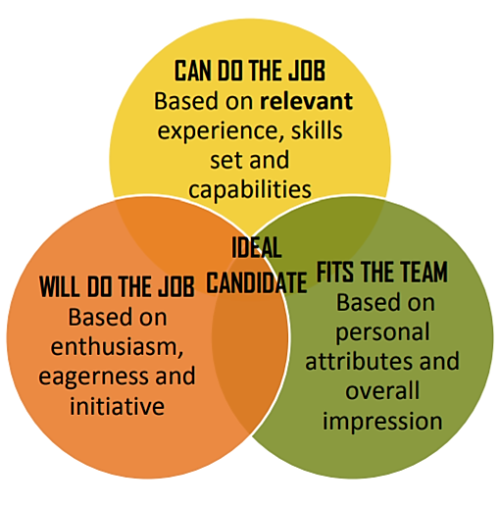
Evaluation Criteria for CVs/Resumes
Educational programs and employers want someone who:

Slide 19
Evaluation Criteria for CVs/Resumes
Readers will evaluate your…
Education, professional training, credentials, and certifications
Relevant professional experience including research
Ability to set and achieve goals and produce positive and if possible, measurable outcomes
Depth of knowledge and competency within your field

Slide 20




Components of a CV/Resume Essential Elements
Personal Details
Name Email Address
Mailing Address Phone number
Academic Qualifications

Slide 21


















Components of a CV/Resume: Optional Elements
Work Experience
Professional Memberships
Awards
Projects
Committees
Certifications
Publications
Community Work
Grants
Research
Conferences Attended
Hobbies & Interests
Presentations
Patents/Inventions
Leadership
Technical Skills

Slide 22
Types of CVs
Academic CV
Function | Length | Focus
Apply for: Academic position Funding Grad school | Flexible; include all that is relevant. | Academic and research achievements Scholarly potential Subject knowledge Awards/honours Accomplishments Service commitment
Hybrid CV
Function | Length | Focus
Apply for: Medical residency Industry research Academic position | Flexible; include all that is relevant. Shorter than an academic CV. | Academic and research achievements Knowledge and skills demonstrated with bullet points Job related experience Accomplishments Volunteer efforts

Slide 23
Types of Resume
Chronological Resume
Highlights job experience with most recent experience first. | Pros | Cons
Highlights job experience with most recent experience first. | Traditional format that is most commonly used | If you don't have related or relevant work experience, it is immediately evident
 | Emphasizes job duties and highlights a steady work history | Gaps in your work history are strongly shown
 | Easiest type of resume to prepare | It poorly highlights or identifies your skills
 | Excellent type to use if you have experience related to the job you are applying for, as it focuses on your employment experience | Not well suited for job seekers who are changing careers

Slide 24
Types of Resume
Functional Resume
Highlights skills and abilities | Pros | Cons
Highlights job experience with most recent experience first. | Consider this format if you have limited or no direct experience, as it de-emphasizes a lack of related work experience | It is not immediately evident the type or amount of work experience you have
 | Enables you to highlight skills as they relate to a specific job and it gives you a strong awareness of who you are and what you can bring to a position | Takes more effort to develop this type of resume
 | Very effective for recent graduates as it allows you to demonstrate skills and capabilities acquired from your studies, volunteering and other areas | Does not demonstrate employment growth and development
 |  | Some employers have trouble following this style of resume or feel this type of resume is hiding employment issues

Slide 25
Types of Resume
Hybrid Resume
Allows you to showcase your most relevant skills while offering reverse chronological detail. | Pros | Cons
Highlights job experience with most recent experience first. | Highlights relevant skills and accomplishments and can be targeted to a specific type of job | Can be confusing if not well written and is more complex and difficult to develop
 | Employers prefer this type of resume over a “pure functional” resume | Takes up more space and makes it challenging to keep resume to 2 pages
 | Uses your work history to show some transferable skills and accomplishments in chronological order

Slide 26
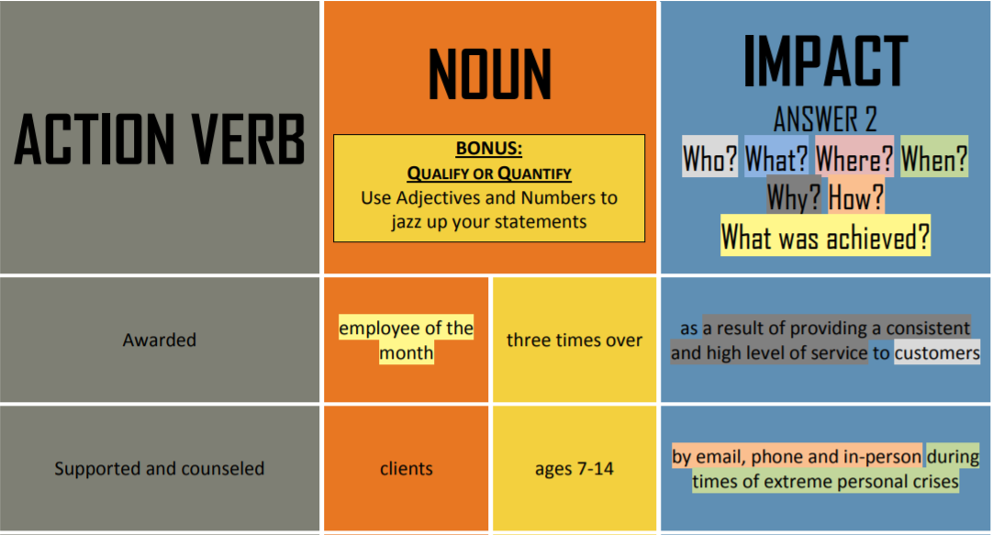
Content Considerations
Show HOW you have demonstrated a skill; don’t just list it.

Slide 27
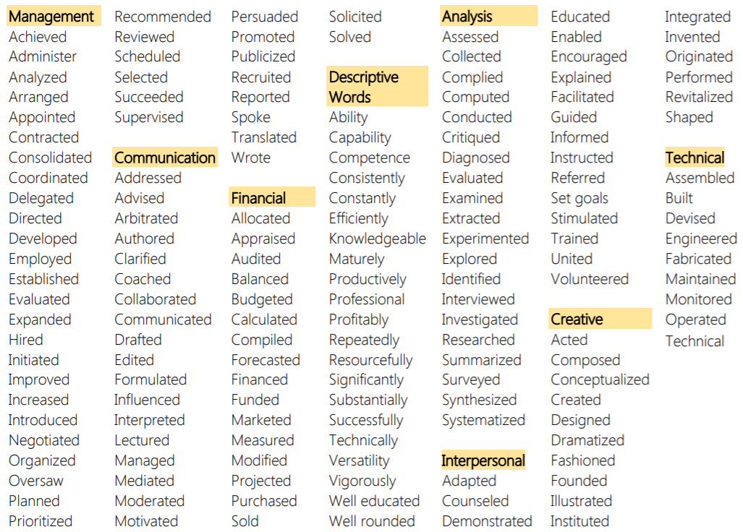
Language Considerations
Use ACTION VERBS

Slide 28
Formatting and Set-Up Tips
Reverse Chronological
Add most recent experience first
Length
For CV : 1-5 Pages
For Resume: Maximum 2 Pages
Logical Layout
Use the format that best suits your suitability
Left Justified
Keep the alignment left justified
Readable Font
11-12 pt font size and a readable font such as Times New Roman, Georgia, Calibri
Emphasize Important Info
Headings should stand out; Try CAPS, larger font, and bold
Consistency
With verb tenses, dates, spacing, and boldface
Running Head
Your name and email address should be at the top of each page
Letterhead
Design a personalized letterhead and use it on all relevant documents
Not too ‘Busy’
Minimize the use of tabs and highlighting techniques

Slide 29
Skills Section
Technical Skills
Required to perform a specific task
Examples: Driving, Coding, Cooking
Transferable Skills
Easily transferred from one situation to another
Examples: Communication skills, Leadership, Teamwork

Slide 30
Profile
Branding
Technical skills
Transferable skills
Impact
Bullets (Optional)

Slide 31
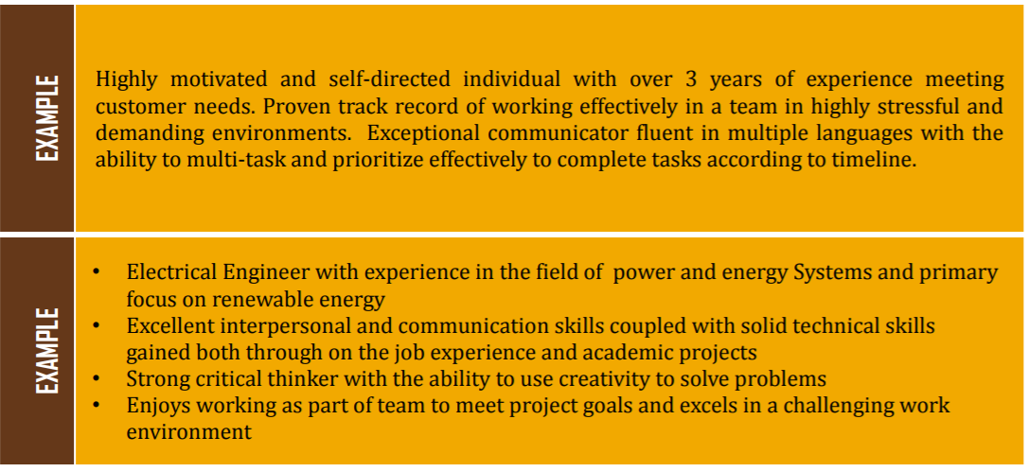
Profile: Sample

Slide 32
Common Errors
Personal pronouns
Narrative style
Long objective statement
Numbered or lettered categories
Acronyms / abbreviations
Slang / colloquialisms
Personal information
GPA/ Percentage/ Marks

Slide 33
Common Errors
Outdated language
References section
Duty listing
Fancy fonts
Unprofessional email address
Routine job duties
‘Busy’
Spelling, grammar or language errors

Slide 34
Electronic Resumes
Use plain text; no highlighting techniques, line breaks, or visual aids
Use simple font styles
List phone number on its own line
Repeat keywords
Do not copy/paste from the job ad
Say ‘work experience’

Slide 35
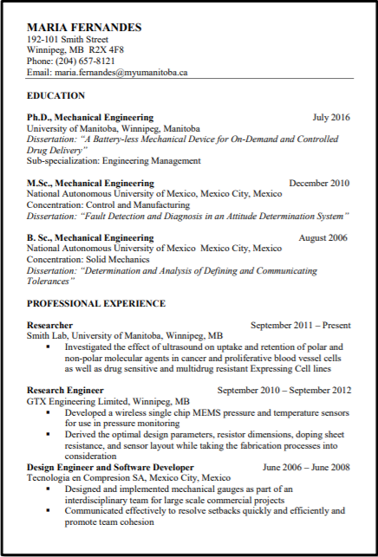
CV for industry

Slide 36
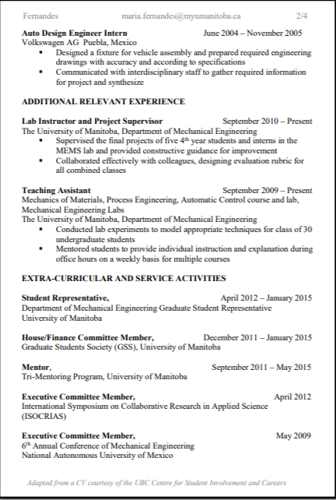
CV for industry

Slide 37
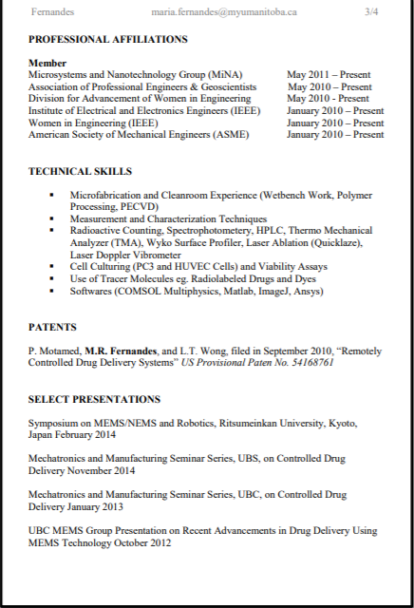
CV for industry

Slide 38
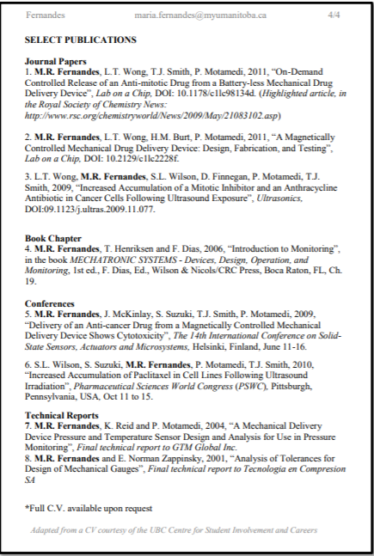
CV for industry

Slide 39
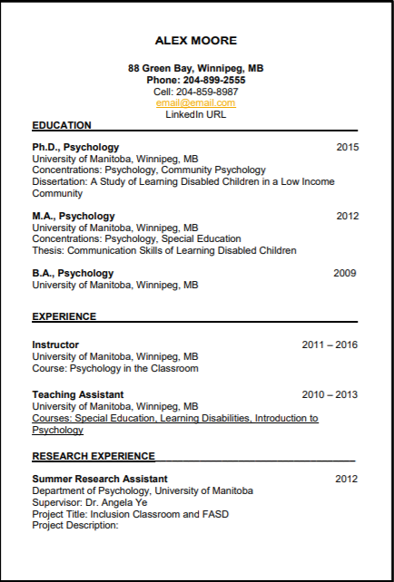
Standard CV

Slide 40
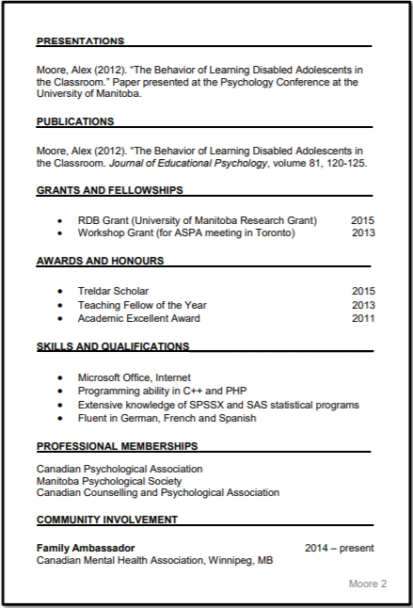
Standard CV

